Slide 1
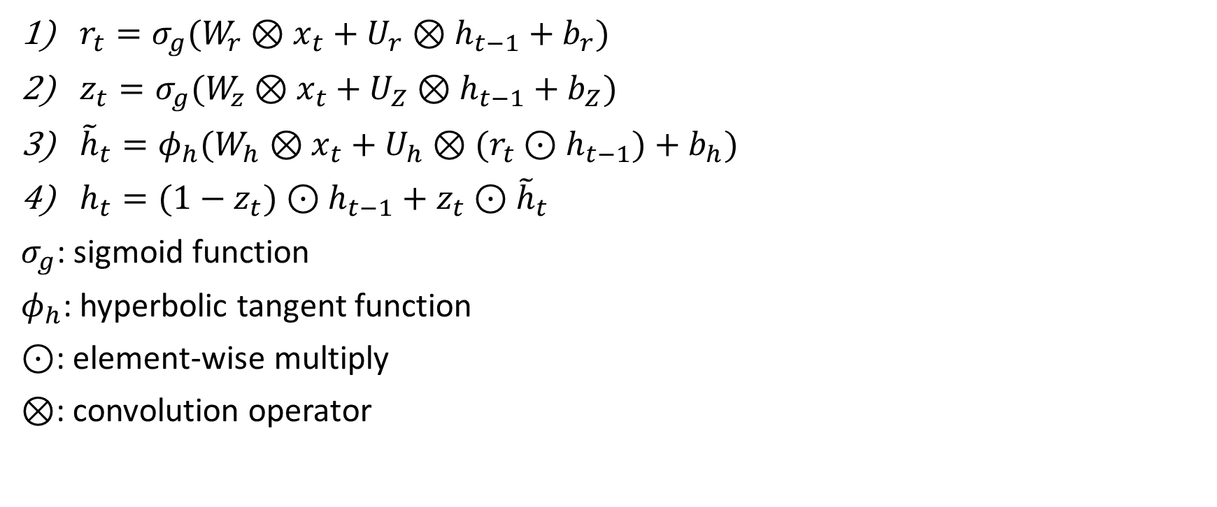
Conv-GRU
$r_{t}=σ_{g}(W_{r}⊗x_{t}+U_{r}⊗h_{t−1}+b_{r})$
$z_{t}=σ_{g}(W_{z}⊗x_{t}+U_{Z}⊗h_{t−1}+b_{Z})$
${\tilde{h}}_{t}=φ_{h}(W_{h}⊗x_{t}+U_{h}⊗(r_{t}⊙h_{t−1})+b_{h})$
$h_{t}=(1−z_{t})⊙h_{t−1}+z_{t}⊙{\tilde{h}}_{t}$
$σ_{g}$: sigmoid function
$φ_{h}$: hyperbolic tangent function
$⊙$: element-wise multiply
$⊗$: convolution operator

Slide 2
論文架構
20200713

Slide 3
第2章 研究背景
2-1 卷積神經網路
2-1-1 卷積層(Convolution layer)
2-1-2 池化層 (Pooling Layer)
2-1-3 全連接層(Fully Connected Layer)
2-2 卷積神經網路模型
2-2-1 VGGNet
2-2-2 ResNet
2-3 Faster R-CNN
2-3-1 Backbone
2-3-2 Region Proposal Networks (RPN)
2-3-3 Detector
2-4 Convolutional Gated Recurrent Unit (Conv-GRU)
2-5 強化學習
2-5-1 基本介紹
2-5-2 回報(Return)
2-5-3 價值函數(value function)
2-5-4 策略(policy, π)
2-5-5 Policy Gradient
2-5-6 REINFORCE
2-6 drl-RPN

Slide 4
第3章 GLOBAL REGION PROPOSALS WITH A HYBRID ATTENTION INTERFACE (GRP-HAI)
3-1 RPN與detector
3-1-1 vgg16與res101
3-1-2 RoIAlign
3-2 Hybrid Attention Interface (HAI)
3-2-1 混合注意力機制 (Hybrid Attention)
3-2-2 模塊架構
3-2-3 狀態空間
3-2-4 動作空間
3-2-5 HAI運作流程
3-2-6 獎勵設計
3-3 模型訓練

Slide 5
Global Region Proposals with a Hybrid Attention Interface (GRP-HAI)

Slide 6
RPN
Detector
Feature extractor
cls
reg
Bounding box regression
feature
maps
RoI Align
Image
+
Bounding box classification
Local region proposals
Visited region
Masked state
Hybrid Attention Interface
Conv layer
+
Concatenate
HAI
Search termination
FC layer
Conv or FC layer
Region
localization

Slide 7
3-1 RPN與detector

Slide 8
vgg16
net | vgg16
conv1 | $$\left[3\text{x}3, 64\right]\text{x}\text{2}$$
conv2_x | 2x2 max pool, stride 2
 | $$\left[3\text{x}3, 128\right]\text{x}\text{2}$$
conv3_x | 2x2 max pool, stride 2
 | $$\left[3\text{x}3, 256\right]\text{x}\text{3}$$
conv4_x | 2x2 max pool, stride 2
 | $$\left[3\text{x}3, 512\right]\text{x}\text{3}$$
conv5_x | 2x2 max pool, stride 2
 | $$\left[3\text{x}3, 512\right]\text{x}\text{3}$$
 | $$\text{4096}\text{−}\text{d} \text{fc} \text{x}\text{2}$$
 | 1000-d fc, , softmax

Slide 9
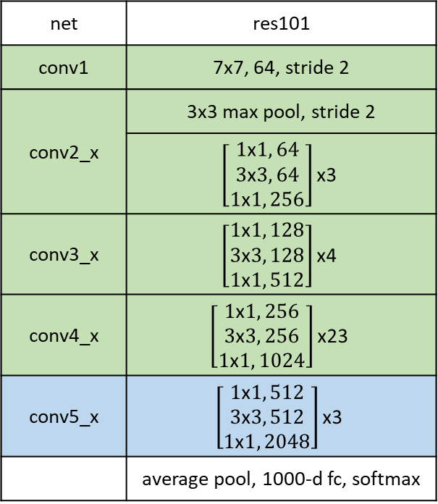
res101
net | res101
conv1 | 7x7, 64, stride 2
conv2_x | 3x3 max pool, stride 2
 | $$\left[\begin{aligned}1\text{x}1, 64 \\ 3\text{x}3, 64 \\ 1\text{x}1, 256\end{aligned}\right]\text{x}\text{3}$$
conv3_x | $$\left[\begin{aligned}1\text{x}1, 128 \\ 3\text{x}3, 128 \\ 1\text{x}1, 512\end{aligned}\right]\text{x}\text{4}$$
conv4_x | $$\left[\begin{aligned}1\text{x}1, 256 \\ 3\text{x}3, 256 \\ 1\text{x}1, 1024\end{aligned}\right]\text{x}\text{23}$$
conv5_x | $$\left[\begin{aligned}1\text{x}1, 512 \\ 3\text{x}3, 512 \\ 1\text{x}1, 2048\end{aligned}\right]\text{x}\text{3}$$
 | average pool, 1000-d fc, softmax

Slide 10
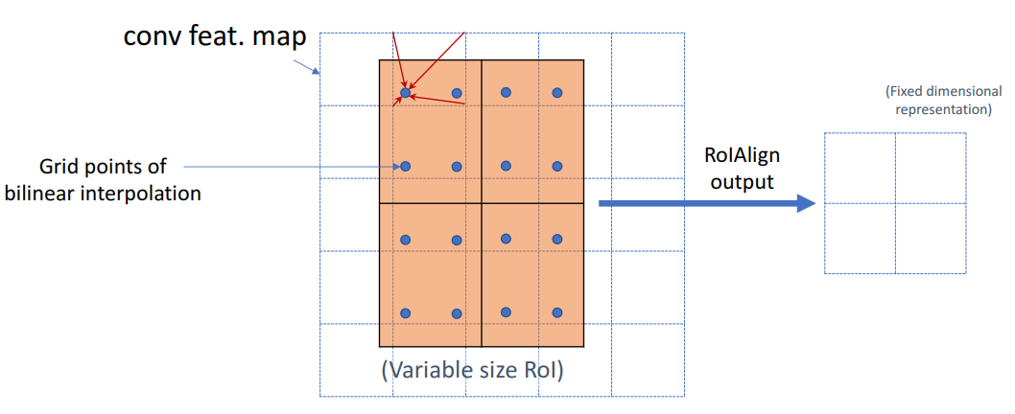
RoIAlign (from Mask R-CNN)

Slide 11
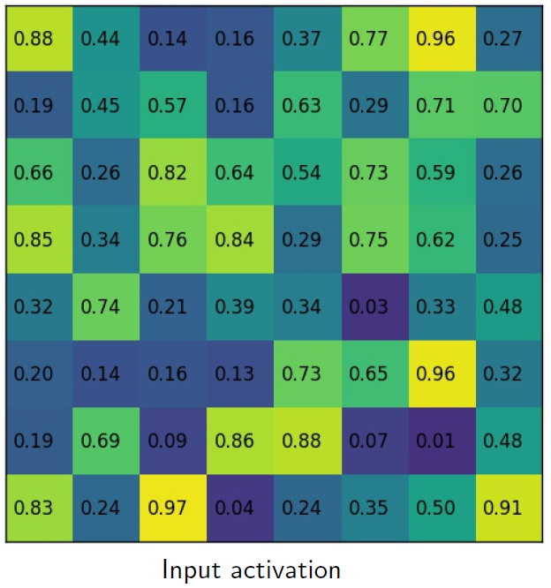
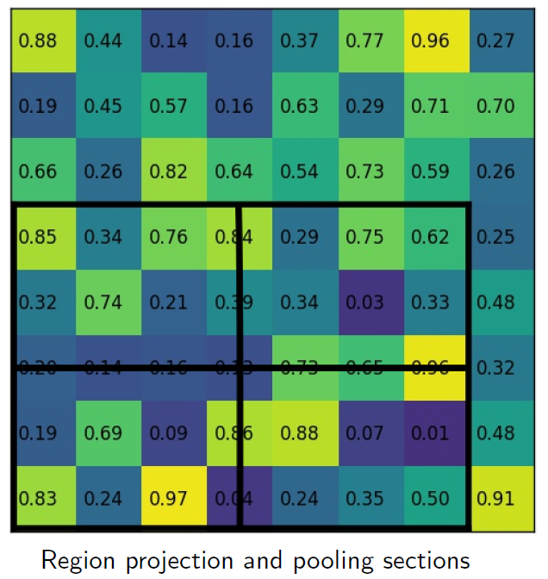
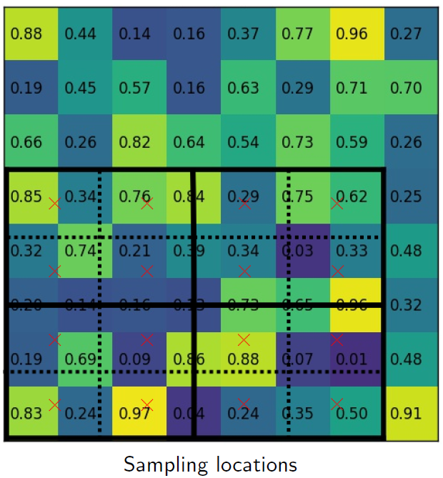
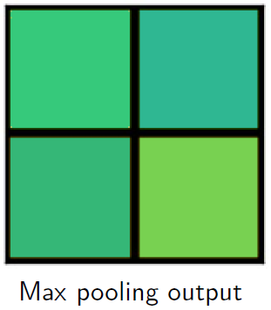
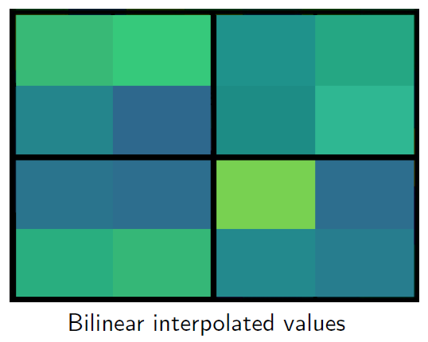

Slide 12
3-2 Hybrid Attention Interface (HAI)

Slide 13
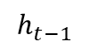

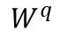
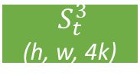
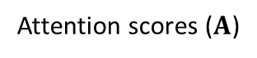
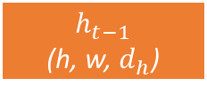
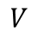
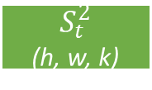
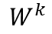
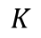
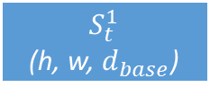
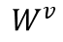
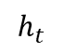
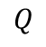
Hybrid Attention Interface (HAI)
$$h_{t}$$
Search termination
$$h_{t−1}$$
Conv-GRU
Soft Attention
path
Concat
Reshape
$$S_{t}^{2}$$
(h, w, k)
$${ S}_{t}^{3}$$
(h, w, 4k)
MatMul
Region localization
$$\underset{i}{argmax}{(∙)}$$
Attention scores ($Α$)
SoftMax
Hard Attention path
Scaled Dot-Product
$$Q$$
$$K$$
$$V$$
Flatten
Flatten
Flatten
Conv
Conv
Conv
$$W^{q}$$
$$h_{t−1}$$
(h, w, $d_{h}$)
$$W^{k}$$
$$S_{t}^{1}$$
(h, w, $d_{base}$)
$$W^{v}$$

Slide 14
3-2-1 混合注意力機制 (Hybrid Attention)

Slide 15
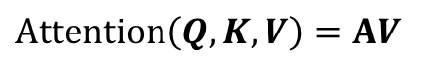
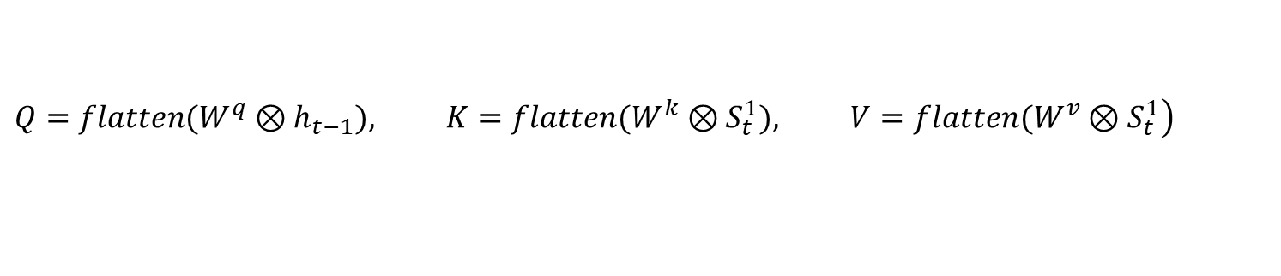
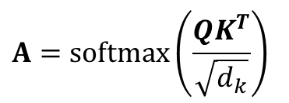
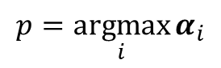
Hybrid Attention
$$Α=softmax\left(\frac{QK^{T}}{\sqrt{d_{k}}}\right)$$
$$Attention\left(Q,K,V\right)=ΑV$$
$$α_{i}=softmax(\sum_{j}{Α_{i,j}), i=0,1,2…,h∗w−1, Α_{i,j}∈Α, Α∈ℛ^{\left(h∗w\right)×\left(h∗w\right)}}$$
$$p=\underset{i}{argmax}{α_{i}}$$
$$Q∈ℛ^{\left(h∗w\right)×d_{k}}, K∈ℛ^{\left(h∗w\right)×d_{k}}, V∈ℛ^{\left(h∗w\right)×d_{v}}$$
$$\left.Q={flatten(W}^{q}⊗h_{t−1}), K=flatten(W^{k}⊗S_{t}^{1}), V=flatten(W^{v}⊗S_{t}^{1}\right)$$
$$W^{q}∈ℛ^{3×3×d_{h}×d_{k}}, W^{k}∈ℛ^{3×3×d_{base}×d_{k}},W^{v}∈ℛ^{3×3×d_{base}×d_{v}}, d_{h}=300$$

Slide 16
3-2-3 狀態空間

Slide 17
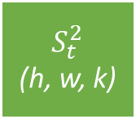

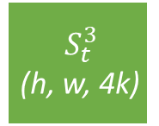
Input state
$$S_{t}^{1}$$
(h, w, $d_{base}$)
$$S_{t}^{2}$$
(h, w, k)
$${ S}_{t}^{3}$$
(h, w, 4k)
$S_{0}^{1}$為backbone輸出的feature maps (正規化到0~1之間)
$S_{0}^{2}$為feature maps經過RPN得到的cls中的物體性(objectness)
$S_{0}^{3}$為RPN輸出的reg除以個別座標修正量的最大值後的正規化結果
$$S_{t}∈ℛ^{h×w×\left(d_{base}+5k\right)}, S_{t}^{1}∈ℛ^{h×w×d_{base}}, S_{t}^{2}∈ℛ^{h×w×k},{ S}_{t}^{3}∈ℛ^{h×w×4k}$$

Slide 18
3-2-4 動作空間

Slide 19
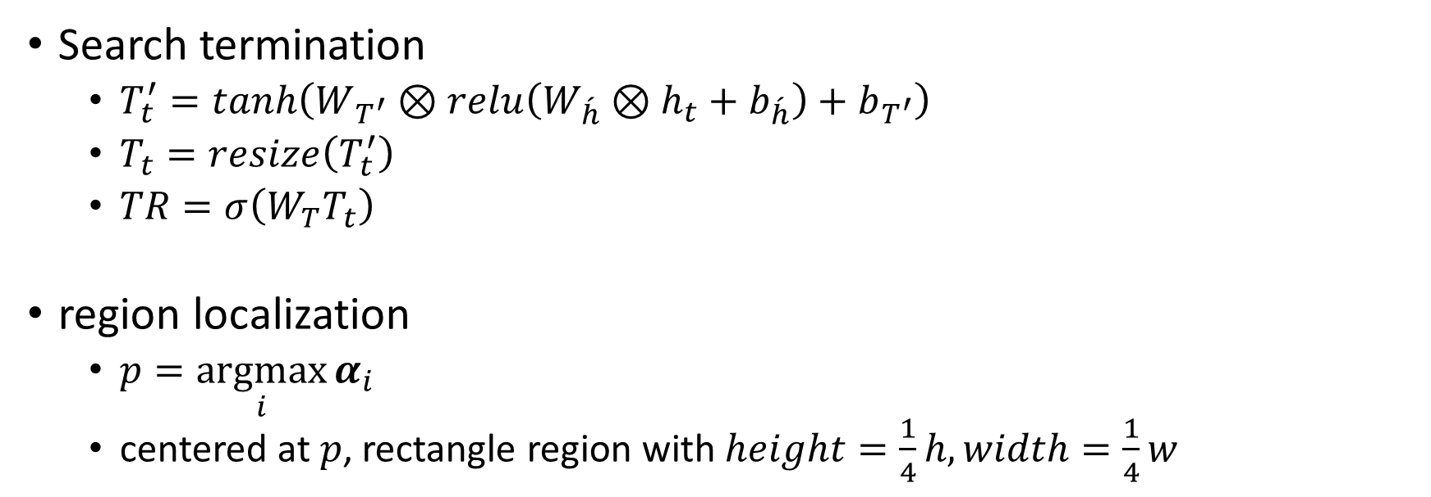
Action
Search termination
$T_{t}^{′}=\tanh\left(W_{T^{′}}⊗relu\left(W_{\acute{h}}⊗h_{t}+b_{\acute{h}}\right)+b_{T^{′}}\right)$
$T_{t}=resize\left(T_{t}^{′}\right)$
$TR=σ\left(W_{T}T_{t}\right)$
region localization
$p=\underset{i}{argmax}{α_{i}}$
centered at $p$, rectangle region with $height=\frac{1}{4}h, width=\frac{1}{4}w$

Slide 20
3-2-5 HAI運作流程

Slide 21
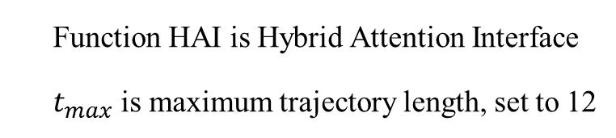
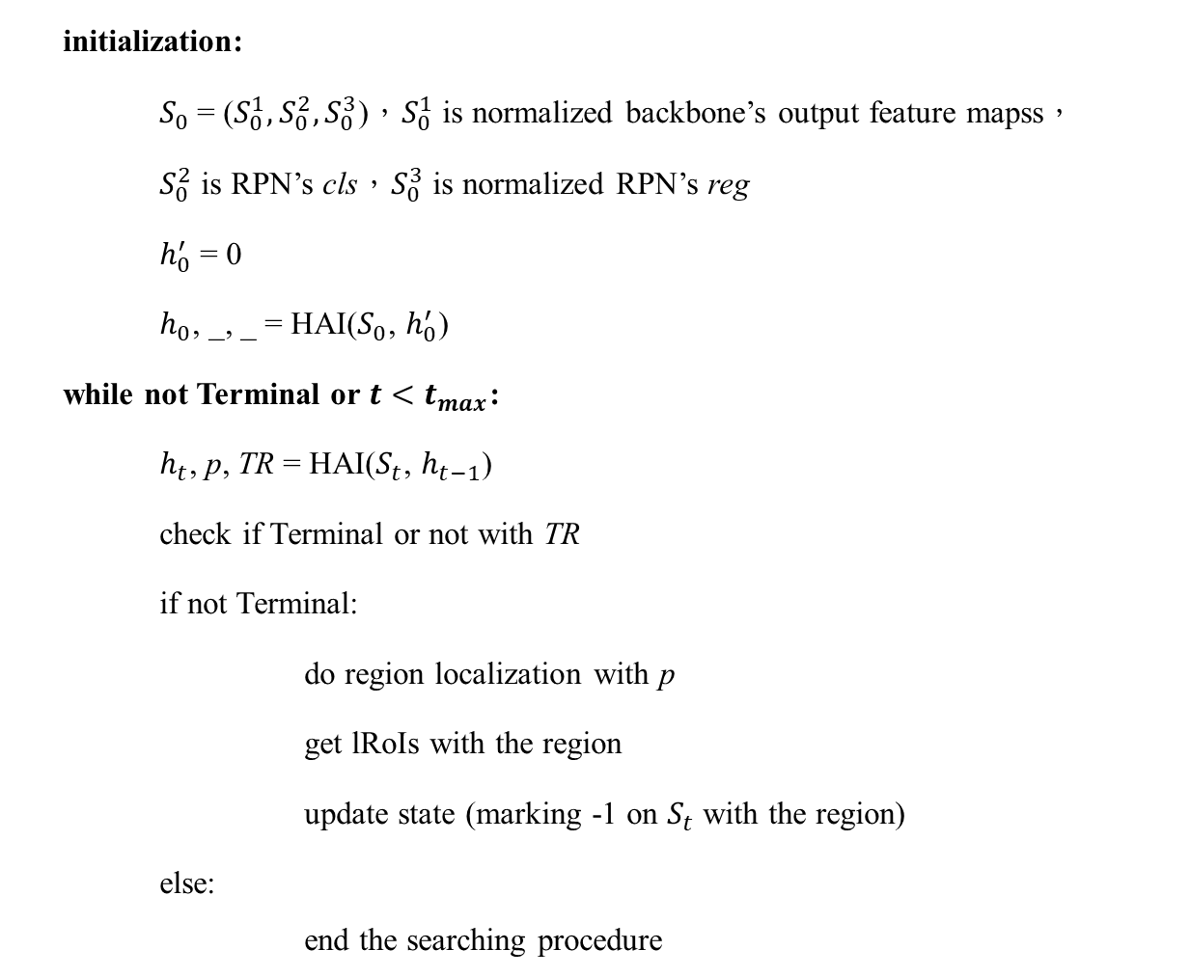
HAI Operation Pseudo Code
initialization:
$S_{0}$= ($S_{0}^{1},S_{0}^{2},S_{0}^{3}$)，$S_{0}^{1}$ is normalized backbone’s output feature mapss，
$S_{0}^{2}$ is RPN’s cls，$S_{0}^{3}$ is normalized RPN’s reg
$h_{0}^{′}$ = 0
$h_{0}$, _, _ = HAI($S_{0}$, $h_{0}^{′}$)
while not Terminal or $t<t_{max}$:
$h_{t}$, p, TR = HAI($S_{t}$, $h_{t−1}$)
check if Terminal or not with TR
if not Terminal:
do region localization with p
get lRoIs with the region
update state (marking -1 on $S_{t}$ with the region)
else:
end the searching procedure
Function HAI is Hybrid Attention Interface
$t_{max}$ is maximum trajectory length, set to 12

Slide 22
3-2-6 獎勵設計

Slide 23
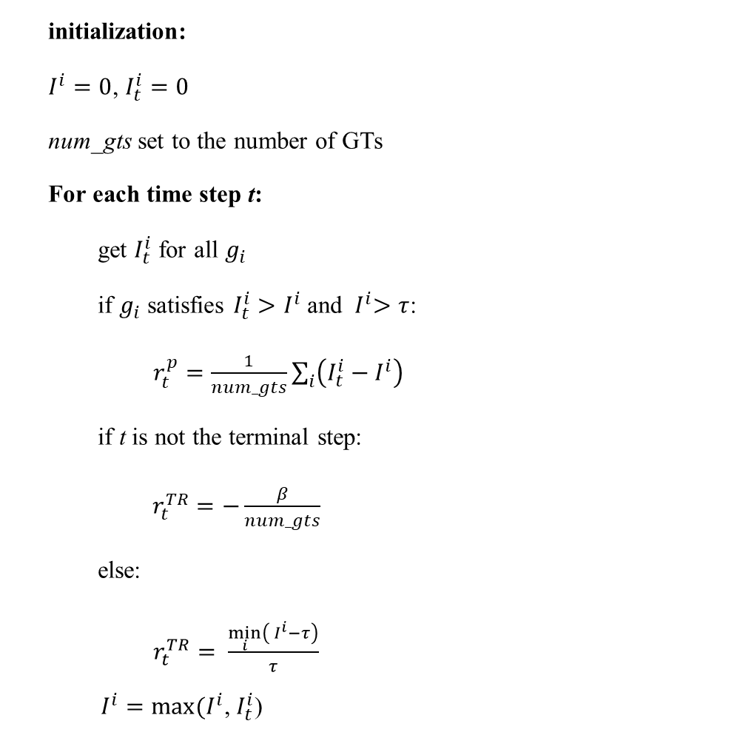
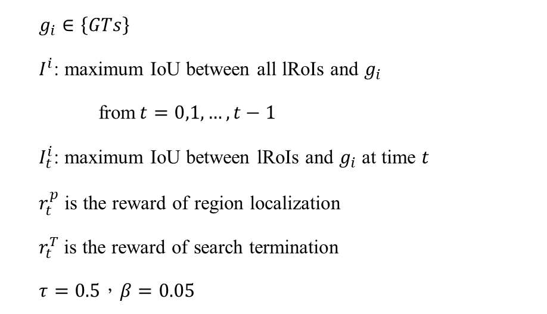
Reward
initialization:
$I^{i}=0$, $I_{t}^{i}=0$
num_gts set to the number of GTs
For each time step t:
get $I_{t}^{i}$ for all $g_{i}$
if $g_{i}$ satisfies $I_{t}^{i}{>I}^{i}$and ${ I}^{i}>τ$:
$r_{t}^{p}=\frac{1}{num_gts}\sum_{i}{\left(I_{t}^{i}−I^{i}\right) }$
if t is not the terminal step:
$r_{t}^{TR}=−\frac{β}{num_gts}$
else:
$r_{t}^{TR}= \frac{\min_{i}\left({ I}^{i}−τ\right)}{τ}$
$I^{i}=max⁡(I^{i}$, $I_{t}^{i}$)
$g_{i}∈\left\{GTs\right\}$
$I^{i}$: maximum IoU between all lRoIs and $g_{i}$
from$t=0,1,…,t−1$
$I_{t}^{i}$: maximum IoU between lRoIs and $g_{i}$ at time $t$
$r_{t}^{p}$ is the reward of region localization
$r_{t}^{T}$ is the reward of search termination
$τ=0.5$，$β=0.05$

Slide 24
3-3 模型訓練

Slide 25
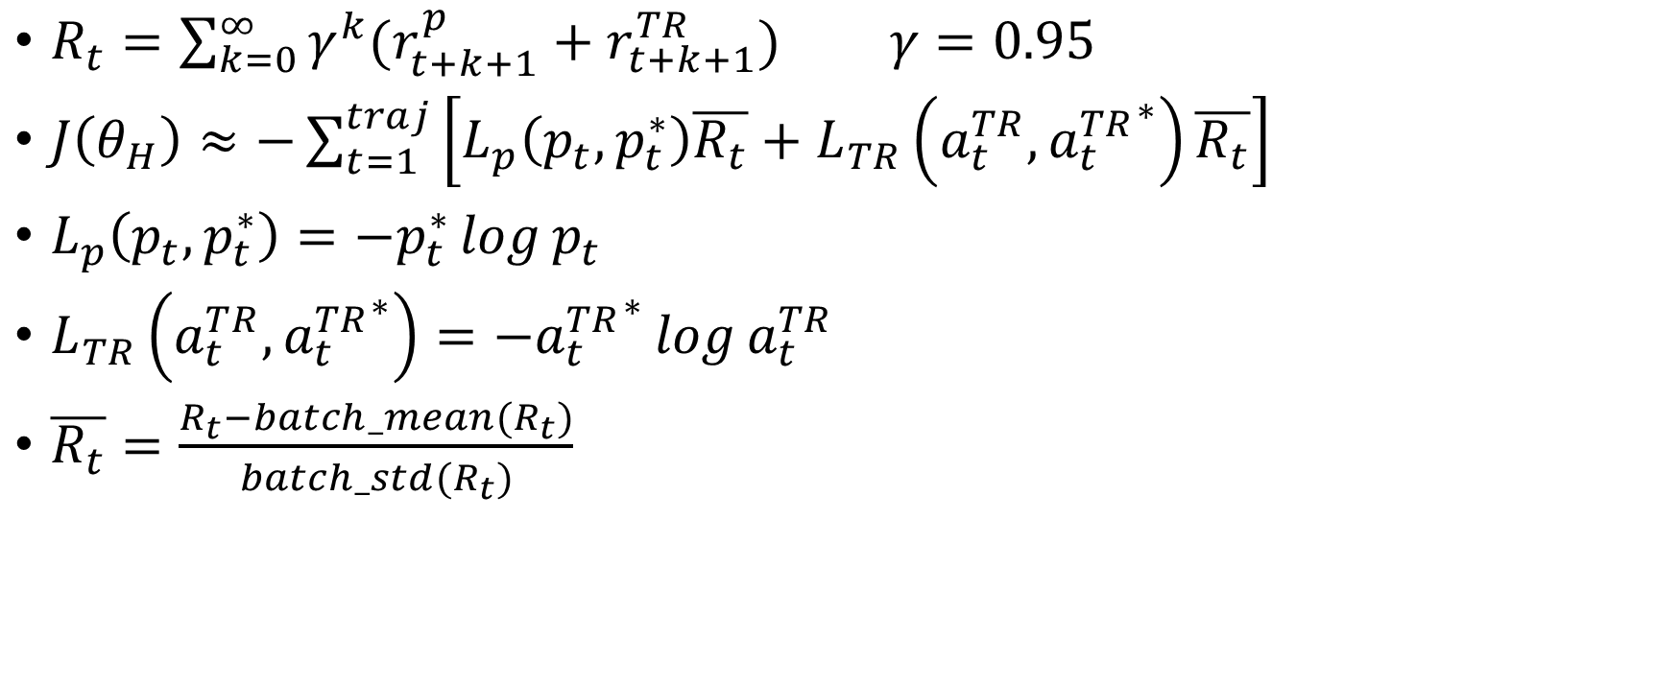
HAI loss function
$R_{t}=\sum_{k=0}^{∞}{γ^{k}(r_{t+k+1}^{p}+r_{t+k+1}^{TR})} γ=0.95$
$J\left(θ_{H}\right)≈−\sum_{t=1}^{traj}{\left[L_{p}\left(p_{t},p_{t}^{∗}\right)\overline{R_{t}}+L_{TR}\left(a_{t}^{TR},{a_{t}^{TR}}^{∗}\right)\overline{R_{t}}\right]}$
$L_{p}\left(p_{t},p_{t}^{∗}\right)=−p_{t}^{∗}\log{p_{t}}$
$L_{TR}\left(a_{t}^{TR},{a_{t}^{TR}}^{∗}\right)=−{a_{t}^{TR}}^{∗}\log{a_{t}^{TR}}$
$\overline{R_{t}}=\frac{R_{t}−batch_mean(R_{t})}{batch_std(R_{t})}$

Slide 26
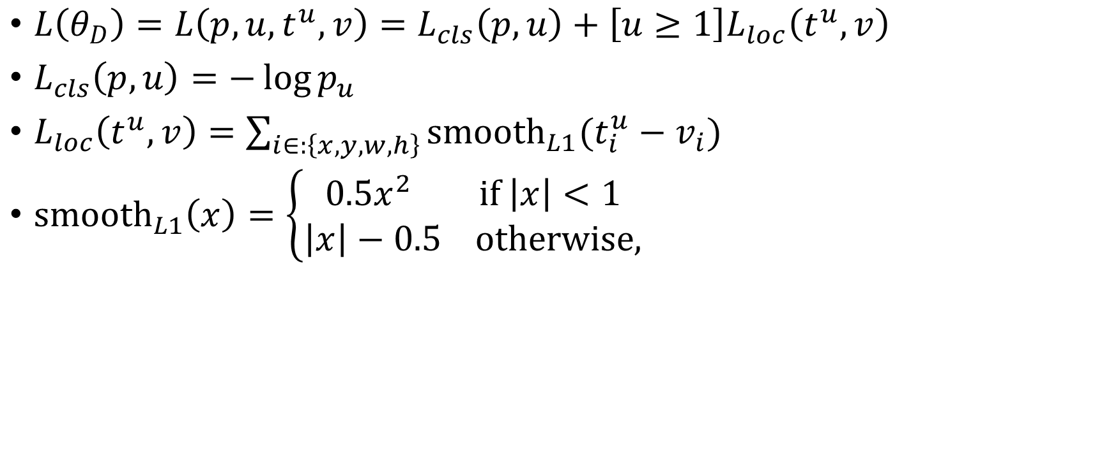
Loss function of Detector
$L\left(θ_{D}\right)=L\left(p,u,t^{u},v\right)=L_{cls}\left(p,u\right)+\left[u≥1\right]L_{loc}\left(t^{u},v\right)$
$L_{cls}\left(p,u\right)=−\log{p_{u}}$
$L_{loc}\left(t^{u},v\right)=\sum_{i∈:\left\{x,y,w,h\right\}}{{smooth}_{L1}(t_{i}^{u}−v_{i})}$
${smooth}_{L1}\left(x\right)=\left\{\begin{aligned}0.5x^{2} if \left|x\right|<1 \\ \left|x\right|−0.5 otherwise,\end{aligned}\right.$

Slide 27
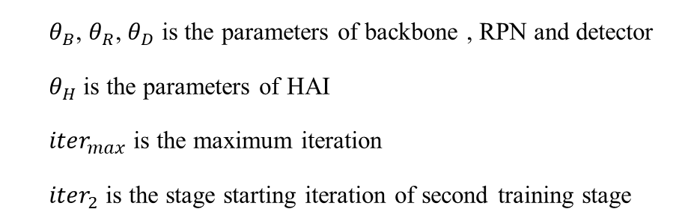
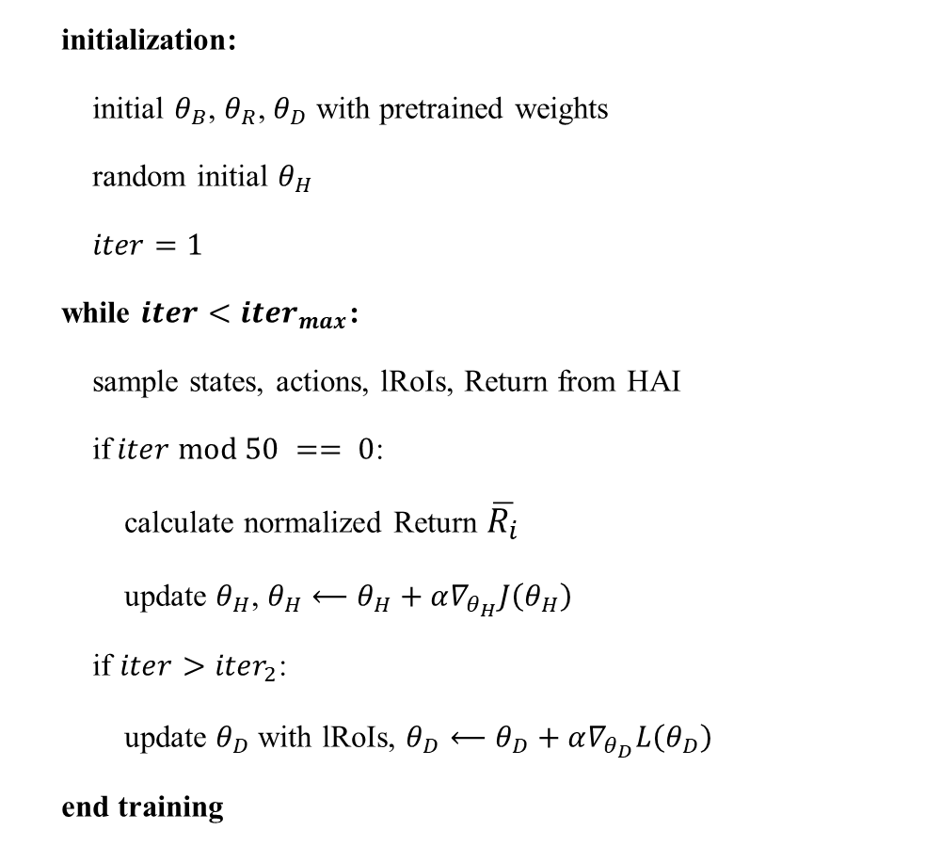
Training Pseudo Code
initialization:
initial $θ_{B}$, $θ_{R}$, $θ_{D}$ with pretrained weights
random initial $θ_{H}$
$iter=1$
while $iter<{iter}_{max}$:
sample states, actions, lRoIs, Return from HAI
if$iter mod 50 == 0$:
calculate normalized Return $\overline{R_{i}}$
update $θ_{H}$, $θ_{H}⟵θ_{H}+α∇_{θ_{H}}J\left(θ_{H}\right)$
if $iter>{iter}_{2}$:
update $θ_{D}$ with lRoIs, $θ_{D}⟵θ_{D}+α∇_{θ_{D}}L\left(θ_{D}\right)$
end training
$θ_{B}$, $θ_{R}$, $θ_{D}$ is the parameters of backbone , RPN and detector
$θ_{H}$ is the parameters of HAI
${iter}_{max}$ is the maximum iteration
${iter}_{2}$ is the stage starting iteration of second training stage

Slide 28
第4章 LOCAL REGION PROPOSALS WITH A HYBRID ATTENTION INTERFACE (LRP-HAI)
4-1 RPN與detector
4-1-1 P4
4-2 Hybrid Attention Interface (HAI)
4-2-1 模塊架構與狀態空間
4-2-2 HAI運作流程

Slide 29
第4章: Local Region Proposals with a Hybrid Attention Interface (LRP-HAI)

Slide 31
LRP-HAI
Detector
Feature extractor
Bounding box regression
Feature maps
Local region proposals
Image
RoI Align
Bounding box classification
Visited region
reg
Masked state
RPN
Conv layer
HAI
Search termination
FC layer
Region
localization
Conv or FC layer

Slide 32
4-1 RPN與detector

Slide 33
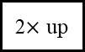
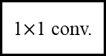
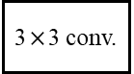
P4
res101
2048
C5
256
P5
1024
C4
256
P4
512
C3
2$×$ up
3$×$3 conv.
C2
1$×$1 conv.
+
C1
Image

Slide 34
3-2-1 混合注意力機制 (Hybrid Attention)

Slide 35
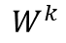
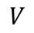
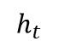
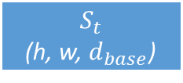
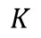
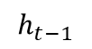
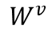
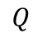
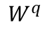
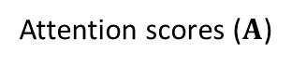
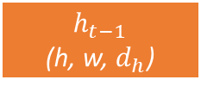

Hybrid Attention Module (HAI)
$$h_{t}$$
Search termination
$$h_{t−1}$$
Conv-GRU
Soft Attention
path
Reshape
MatMul
Region
localization
$$\underset{i}{argmax}{(∙)}$$
Attention scores ($Α$)
Hard Attention path
SoftMax
Scaled Dot-Product
$$Q$$
$$K$$
$$V$$
Flatten
Flatten
Flatten
Conv
Conv
Conv
$$W^{q}$$
$$h_{t−1}$$
(h, w, $d_{h}$)
$$W^{k}$$
$$S_{t}$$
(h, w, $d_{base}$)
$$W^{v}$$

Slide 36
4-2-1 模塊架構與狀態空間

Slide 37

Input state
$$S_{t}$$
(h, w, $d_{base}$)

Slide 38
4-2-2 HAI運作流程

Slide 39


HAI Operation Pseudo Code
initialization:
$S_{0}$is normalized backbone’s output feature maps
$h_{0}^{′}$ = 0
$h_{0}$, _, _= HAI($S_{0}$, $h_{0}^{′}$)
while not Terminal:
$h_{t}$, p, TR = HAI($S_{t}$, $h_{t−1}$)
check if Terminal or not with TR
if not Terminal:
do region localization with p
input the region to RPN and then output lRoIs
update state (marking -1 on $S_{t}$ with the region)
else:
end the searching procedure
HAI is Hybrid Attention Module
$t_{max}$ is maximum trajectory length, set to 12

Slide 40
第5章 模擬實驗
5-1 實驗環境
5-2 實驗資料集
5-2-1 Pascal VOC
5-2-2 MS COCO
5-2-3 骨髓細胞資料集
5-2-4 大腸鏡資料集
5-3 實作細節
5-4 評量指標
5-4-1 混淆矩陣(Confusion Matrix)
5-4-2 Average Precision (AP)與Average Recall (AR)
5-4-3 不同資料集的評量方式
5-5 實驗結果
5-5-1 Pascal VOC上之實驗
5-5-2 骨髓細胞資料集上之實驗
5-5-3 MS COCO上之實驗
5-5-4 大腸鏡資料集上之實驗
5-5-5 運行時間比較

Slide 41
第五章: 實驗

Slide 42
5-2 實驗資料集

Slide 43
Datasets
Pascal VOC
MS COCO
骨髓細胞資料集(浙大)
大腸鏡資料集()

Slide 44
5-3 實作細節

Slide 46
5-4 評量指標

Slide 47
5-4-1 混淆矩陣(Confusion Matrix)

Slide 48



Evaluate Metrics
$$Precision=\frac{TP}{TP+FP}=\frac{TP}{all detections}$$
$$Recall=\frac{TP}{TP+FN}=\frac{TP}{all ground truths}$$

Slide 49
5-4-1 Average Precision (AP)與Average Recall (AR)

Slide 50
Average Precision (AP)
Rank | 信心指數 | 對應ground-truth | IoU > 0.5 | Precision | Recall
1 | 0.9 | 1 | 1 | 1/1=1 | 1/4=0.25
2 | 0.8 | 2 | 1 | 2/2=1 | 2/4=0.5
3 | 0.7 | 3 | 1 | 3/3=1 | 3/4=0.75
4 | 0.6 | 1 | 0 | 3/4=0.75 | 3/4=0.75
5 | 0.4 | 4 | 0 | 3/5=0.6 | 3/4=0.75

Slide 51
P-R curve

Slide 52
5-4-1 不同資料集的評量方式

Slide 53


AP
Pascal VOC
$AP=\frac{1}{11}\sum_{r∈\{0,0.1,0.2,…,1\}}{P_{interp}(r)}$
$P_{interp}\left(r\right)=\max_{\hat{r}≥r}{p(\hat{r})}$
MS COCO

Slide 54



PASCAL_VOC
Model |  | Avg. # of glimpses | Avg . glimpsed region (%) | ${AP}_{50}$ (%) | AP$ρ$ | gc
vgg16 | drl-RPN | 5.93 | 30.30 | 77.32 | 2.55 | 13.03
 | GRP-HAI | 4.16 | 23.03 | 76.85 | 3.34 | 18.45
 | LRP-HAI | 4.47 | 24.59 | 76.39 | 3.11 | 17.09
res101 | drl-RPN | 7.12 | 37.87 | 81.05 | 2.14 | 11.38
 | GRP-HAI | 4.33 | 19.49 | 78.78 | 4.04 | 18.18
 | LRP-HAI | 4.07 | 22.09 | 80.41 | 3.64 | 19.75
P4 | drl-RPN | 5.84 | 33.40 | 81.08 | 2.43 | 13.87
 | GRP-HAI | 2.43 | 13.99 | 79.29 | 5.67 | 32.58
 | LRP-HAI | 2.93 | 16.57 | 79.76 | 4.81 | 27.20
AP_density (AP$ρ$) = ${{AP}_{50}}/{\text{Avg}\text{ . }\text{glimpsed} \text{region}\text{ (\%)} }$
glimpse contribution (gc) = ${{AP}_{50}}/{\text{Avg}\text{. \# }\text{of} \text{glimpses} }$

Slide 55
5-5 實驗結果

Slide 56
5-5-1 Pascal VOC上之實驗

Slide 59


Slide 60
5-5-2 骨髓細胞資料集上之實驗

Slide 61

骨髓細胞
Model |  | $$AP$$ | $${AP}_{50}$$ | $${AP}_{75}$$ | $${AP}_{s}$$ | $${AP}_{m}$$ | $${AP}_{l}$$ | $${AR}_{1}$$ | $${AR}_{10}$$ | $${AR}_{100}$$ | $${AR}_{s}$$ | $${AR}_{m}$$ | $${AR}_{l}$$
vgg16 | drl-RPN | 71.78 | 89.10 | 81.37 | 91.33 | 89.03 | 71.00 | 61.48 | 82.95 | 82.95 | 91.33 | 89.02 | 81.50
 | GRP-HAI | 72.32 | 89.79 | 82.12 | 91.33 | 90.20 | 71.02 | 59.97 | 81.59 | 81.59 | 91.33 | 90.19 | 79.84
 | LRP-HAI | 72.37 | 88.83 | 81.15 | 91.33 | 89.22 | 71.83 | 61.58 | 83.15 | 83.15 | 91.33 | 89.20 | 81.65
res101 | drl-RPN | 74.58 | 92.37 | 79.85 | 94.67 | 90.07 | 73.04 | 59.24 | 82.07 | 82.07 | 94.67 | 90.06 | 80.14
 | GRP-HAI | 73.29 | 91.77 | 79.50 | 92.67 | 90.89 | 70.81 | 58.52 | 80.52 | 80.52 | 92.67 | 90.89 | 78.05
 | LRP-HAI | 73.84 | 92.59 | 79.48 | 92.67 | 90.23 | 72.07 | 59.16 | 81.08 | 81.08 | 92.67 | 90.23 | 79.02
P4 | drl-RPN | 72.52 | 90.78 | 81.60 | 94.67 | 91.14 | 73.53 | 59.52 | 81.88 | 81.88 | 94.67 | 91.16 | 79.90
 | GRP-HAI | 74.63 | 93.13 | 82.15 | 94.67 | 90.12 | 76.41 | 60.09 | 82.51 | 82.51 | 94.67 | 90.13 | 81.19
 | LRP-HAI | 74.04 | 90.72 | 81.59 | 94.67 | 89.01 | 75.72 | 60.42 | 82.92 | 82.92 | 94.67 | 89.03 | 81.64

Slide 64

Model |  | Avg. # of glimpses | Avg . glimpsed region (%) | ${AP}_{50}$ (%) | AP$ρ$ | gc
vgg16 | drl-RPN | 7.79 | 45.24 | 89.10 | 1.97 | 11.44
 | GRP-HAI | 2.65 | 15.61 | 89.79 | 5.75 | 33.91
 | LRP-HAI | 2.77 | 16.30 | 88.83 | 5.45 | 32.08
res101 | drl-RPN | 6.90 | 29.21 | 92.37 | 3.16 | 13.39
 | GRP-HAI | 2.69 | 15.64 | 91.77 | 5.87 | 34.08
 | LRP-HAI | 2.62 | 15.61 | 92.59 | 5.93 | 35.40
P4 | drl-RPN | 6.59 | 27.74 | 90.78 | 3.27 | 13.77
 | GRP-HAI | 2.63 | 15.65 | 93.13 | 5.95 | 35.46
 | LRP-HAI | 2.67 | 15.82 | 90.72 | 5.74 | 33.97

Slide 67


Slide 68
5-5-3 MS COCO上之實驗

Slide 69

MS COCO
Model |  | $$AP$$ | $${AP}_{50}$$ | $${AP}_{75}$$ | $${AP}_{s}$$ | $${AP}_{m}$$ | $${AP}_{l}$$ | $${AR}_{1}$$ | $${AR}_{10}$$ | $${AR}_{100}$$ | $${AR}_{s}$$ | $${AR}_{m}$$ | $${AR}_{l}$$
P4 | drl-PRN | 32.19 | 50.98 | 34.82 | 13.56 | 38.33 | 49.57 | 29.03 | 42.26 | 43.14 | 17.80 | 52.84 | 64.80
 | GRP-HAI | 33.59 | 52.69 | 36.41 | 14.33 | 39.94 | 51.19 | 29.68 | 43.56 | 44.67 | 18.49 | 55.24 | 65.34
 | LRP-HAI | 32.77 | 52.03 | 35.58 | 13.80 | 39.48 | 49.36 | 29.24 | 42.76 | 43.80 | 18.10 | 54.54 | 63.75

Slide 70

Model |  | Avg. # of glimpses | Avg . glimpsed region (%) | ${AP}_{50}$ (%) | AP$ρ$ | gc
P4 | drl-PRN | 9.32 | 33.46 | 50.98 | 1.52 | 5.47
 | GRP-HAI | 7.68 | 37.81 | 52.69 | 1.39 | 6.86
 | LRP-HAI | 7.12 | 35.72 | 52.03 | 1.46 | 7.31

Slide 73


Slide 74
5-5-4 大腸鏡資料集上之實驗

Slide 75

Model |  | Avg. # of glimpses | Avg . glimpsed region (%) | ${AP}_{50}$ (%) | AP$ρ$ | gc
P4 | drl-PRN | 3.01 | 15.45 | 90.82 | 5.88 | 30.19
 | GRP-HAI | 1.03 | 6.48 | 90.86 | 14.03 | 88.51
 | LRP-HAI | 1.03 | 6.53 | 90.87 | 13.91 | 87.93

Slide 77






drl-RPN
GRP-HAI
LRP-HAI

Slide 78






drl-RPN
GRP-HAI
LRP-HAI

Slide 79

5-5-5運行速度與${AP}_{50}$比較

Slide 80

運作時間比較(Pascal VOC)
Model | Avg. runtime / image | ${AP}_{50}$ (%)
P4 drl-RPN | 0.309 | 81.08
P4 GRP-HAI | 0.219 | 79.29
P4 LRP-HAI | 0.160 | 79.76

Slide 82
第6章: 結論與未來展望

